Slide 1
Possible design for volcanic data platform (PePPEr)
Samuel Mitchell

Slide 2
PePPEr: A Permeability Porosity and Pycnometry volcanic Eruption sample database
Home
Data plotter
Download data
Upload new data
Polydispersivity tool
Literature finder
Welcome to PePPEr
Description of the database [will add this at a later date]
Basic functions:
Plotter for existing porosity, permeability and pycnometry data
Download database or upload new data
Calculate polydispersivity for particle size distributions
[Example images of plots of volcanic rock ← Sam will provide]
Powered by Django, © Mitchell, Colombier et al. 2023

Slide 3
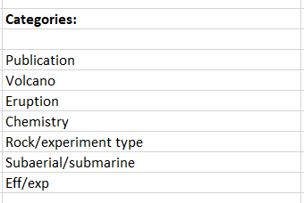
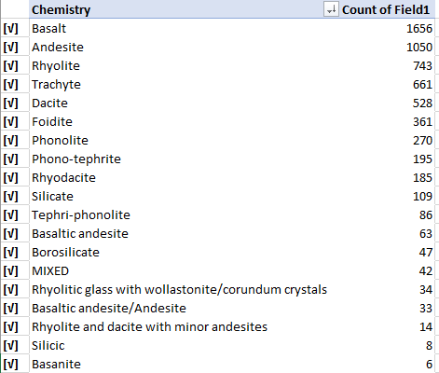
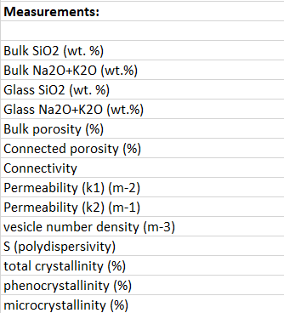
PePPEr: A Permeability Porosity and Pycnometry volcanic Eruption sample database
Home
Data plotter
Download data
Upload new data
Polydispersivity tool
Literature finder
Plotting data of interest using PePPEr
Use this tool to explore the entire PePPEr database. Select what categories you wish to view data by and use the plotter to visualize those selections:
Choose data by category selection Plot of: x-axis vs. y-axis
Plot selection >>>
Powered by Django, © Mitchell, Colombier et al. 2023

Slide 4
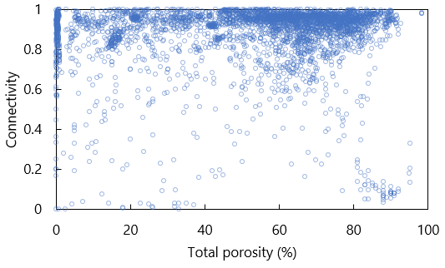
PePPEr: A Permeability Porosity and Pycnometry volcanic Eruption sample database
Home
Data plotter
Download data
Upload new data
Polydispersivity tool
Literature finder
Plotting data of interest using PePPEr
Use this tool to explore the entire PePPEr database. Select what categories you wish to view data by and use the plotter to visualize those selections [example plot shown]:
Graphical tools
X-limits
Y-limits
Colour scheme
Capture plot image
Download plot data
<< Create another plot
Powered by Django, © Mitchell, Colombier et al. 2023

Slide 5
PePPEr: A Permeability Porosity and Pycnometry volcanic Eruption sample database
Home
Data plotter
Download data
Upload new data
Polydispersivity tool
Literature finder
Downloading the PePPEr database
Last updated: XX/XX/XXXX
From here you can download either the entire PePPEr database, or choose from a selection of popular data choices. Use the data plotter tool to download specific data you have plotted.
Download whole database
Download explosive only
Download effusive only
Download experimental only
Download natural rocks only
Download subaerial only
Download submarine only
Powered by Django, © Mitchell, Colombier et al. 2023

Slide 6
PePPEr: A Permeability Porosity and Pycnometry volcanic Eruption sample database
Home
Data plotter
Download data
Upload new data
Polydispersivity tool
Literature finder
Uploading new data to PePPEr
Have you collected your own data (new or existing) that is not yet within the database?
Download the database template and follow the data instructions to have your data included in the database.
Note, all data submitted will be reviewed before updating PePPEr to ensure that formatting and units are all consistent with existing data.
Any questions regarding the upload can be directed to sam.mitchell@bristol.ac.uk
Download database template
Uploading data instructions
Upload new data
Submit for review
Powered by Django, © Mitchell, Colombier et al. 2023

Slide 7
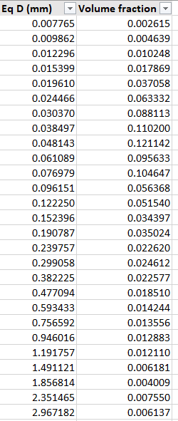
PePPEr: A Permeability Porosity and Pycnometry volcanic Eruption sample database
Home
Data plotter
Download data
Upload new data
Polydispersivity tool
Literature finder
Calculate polydispersivity (S) of your data
Calculate polydispersivity (S) for your particle size distribution (bubbles, vesicles, crystals, grains).
[Add some more information about polydispersivity in volcanic literature].
Input data as particle diameter (in mm) and volume fraction (of 1.00) below:
Calculated S =
Calculated Md50 =
Calculated sorting (1sig) =
Calculated IQR (25-74)=
Calculated IPR (10-90)=
Powered by Django, © Mitchell, Colombier et al. 2023

Slide 8
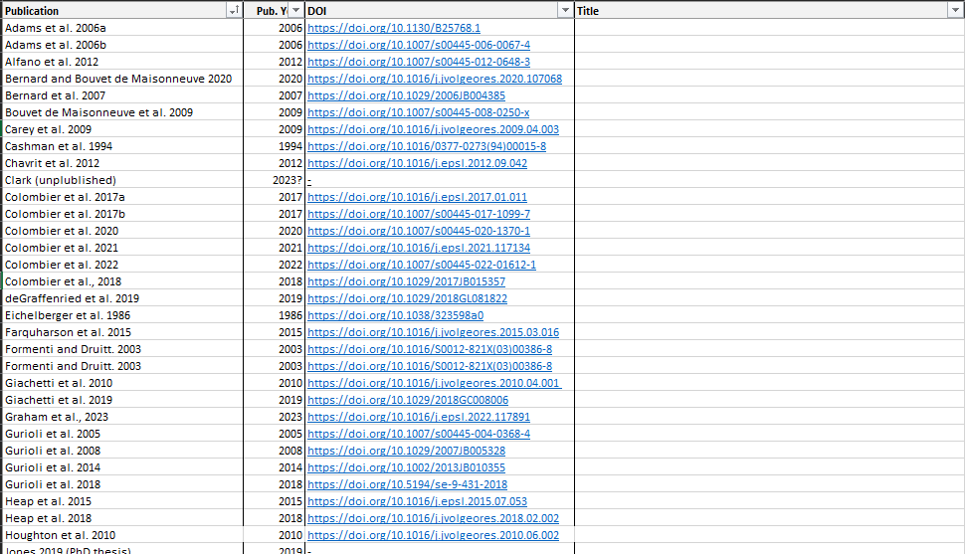
PePPEr: A Permeability Porosity and Pycnometry volcanic Eruption sample database
Home
Data plotter
Download data
Upload new data
Polydispersivity tool
Literature finder
Literature of the PePPEr database
Here you can find all of the literature and sources currently included in the PePPEr database.
[Scrolling inbuilt table?]
Download literature list
Powered by Django, © Mitchell, Colombier et al. 2023

